Slide 1
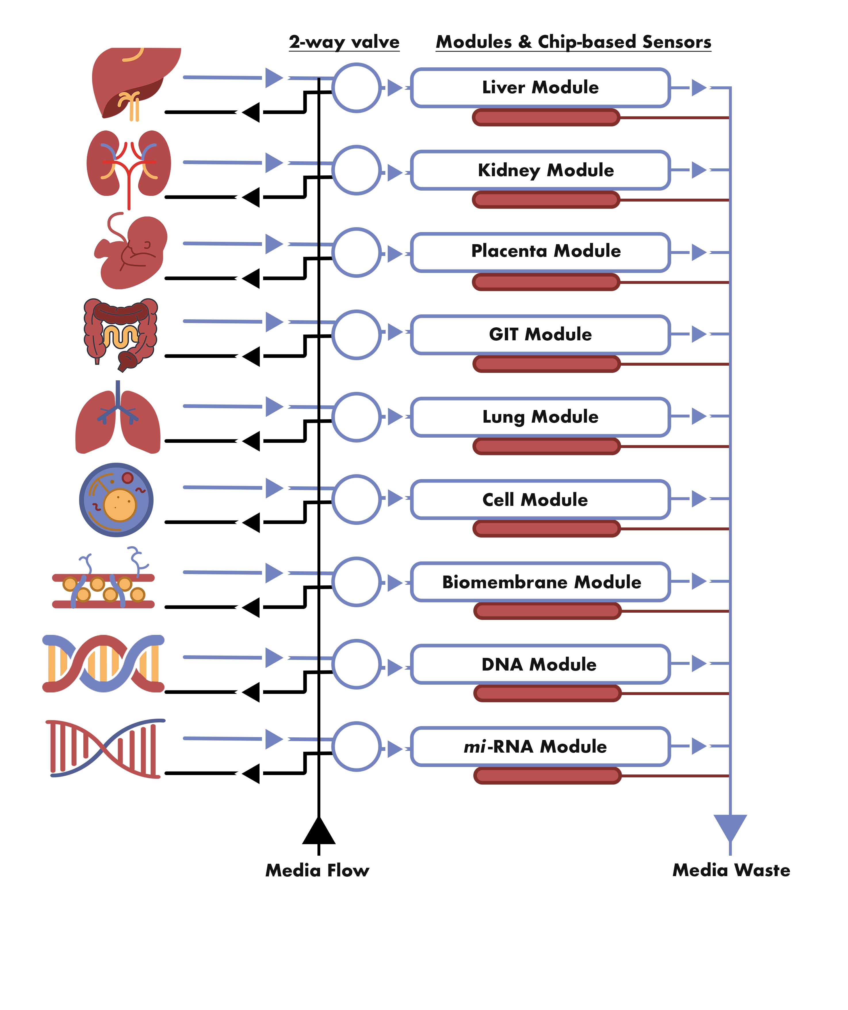
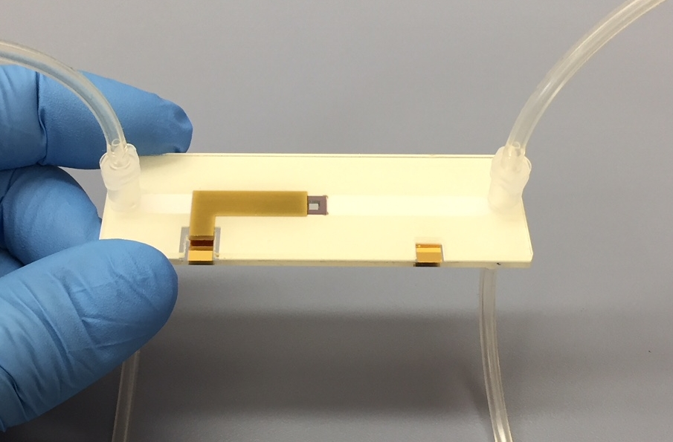
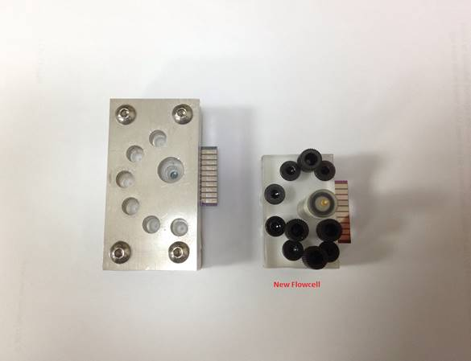
HISENTS VISION
HISENTS PROGRAMME
HISENTS will deliver a novel high throughput screening platform;
Platform configured through flow modules containing individual targets within integrated flow system;
HISENTS puts industrial impact as a high priority;
Implicit in HISENTS is a focused end deliverable as on left.

